Slide 1
C –MYC The Myc proto-oncogene protein, often referred to as c-Myc, is a multifunctional transcription factor that plays a crucial role in regulating various cellular processes, including cell growth, proliferation, metabolism, and apoptosis (programmed cell death). Deregulation of c-Myc is a hallmark of many types of cancer, including breast, colon, lung, and hematological malignancies.

Slide 2
COLLECTING OF DATASET
Datasets from CHEMBL
Oragnism(human), ID CHEMBL1250348
936 uncleaned ic50 dataset
899 cleaned dataset

Slide 3
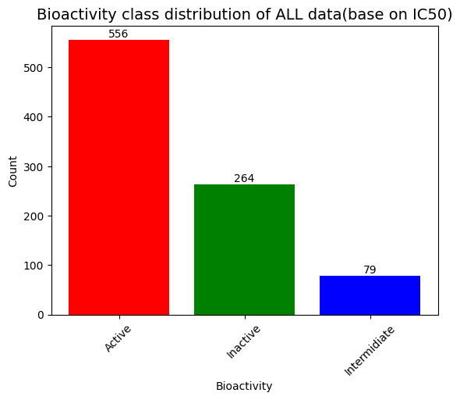
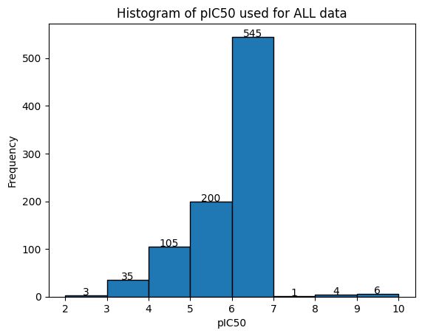

Slide 4
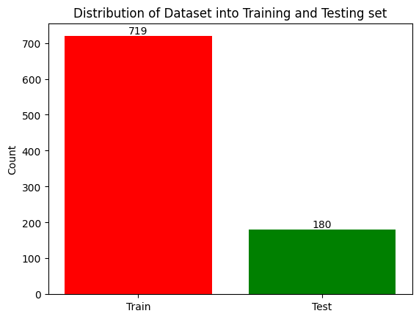

Slide 5
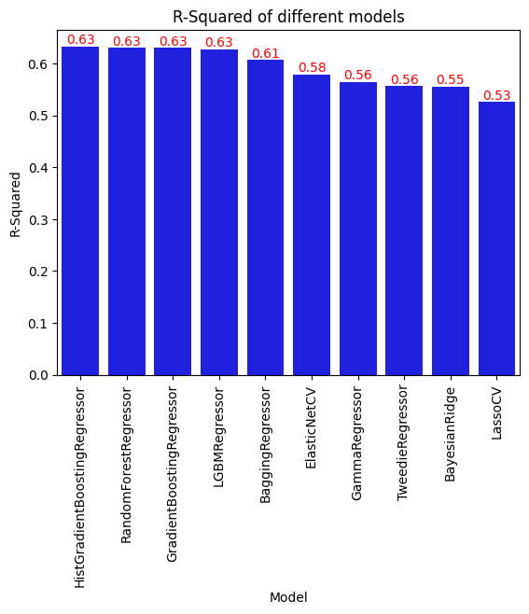
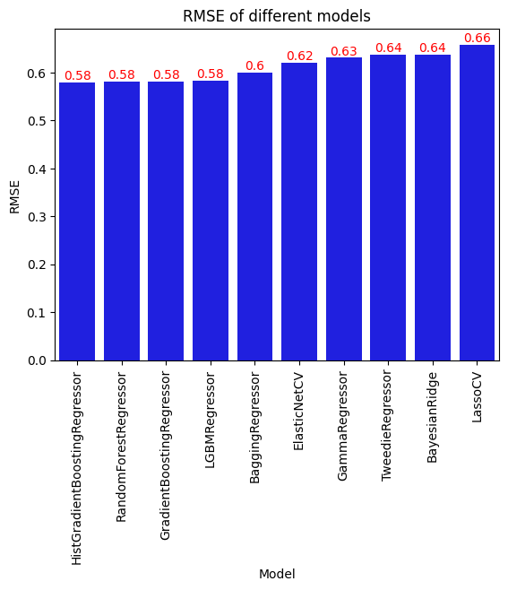

Slide 6
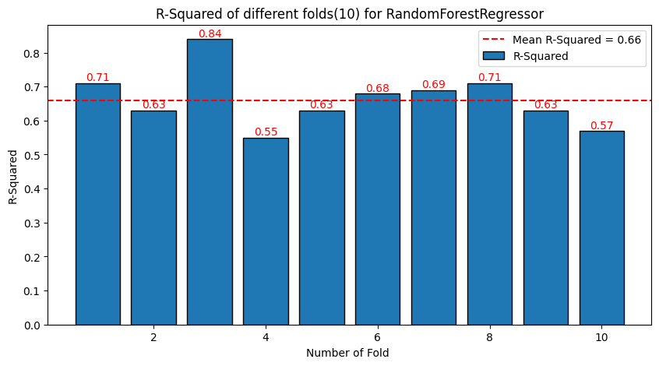
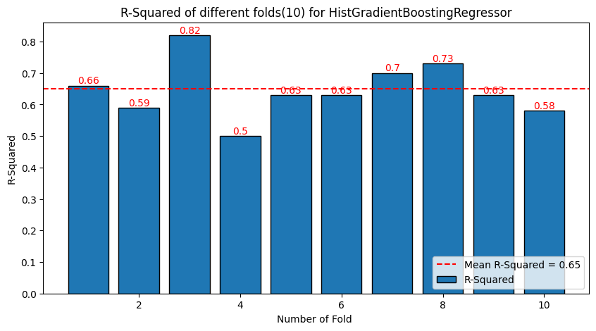

Slide 7
